Slide 1
WP8 Staff & User Training
5. November, 2019
Author: Thomas H. Rod, ESS

Slide 2
Summary
Not much has happened so far (according to plan)
… but now we become seriously dependent on you
… and probably also some of your colleagues!

Slide 3
Objectives
Provide infrastructure for e-learning
Staff training in data stewardship and e-learning
User training in PaNOSC services and facilities
Topic | 2019 |  |  |  | 2020 |  |  |  | 2021 |  |  | 2022
Infrastructure
Staff training
User training

Slide 4
Resources and distribution
Total effort: 109 PM
All tasks are led by either ELI or ESS, but all P&N partners have resources!
⚠️ Rely on partners for training material
⚠️ Rely on work packages for training material

Slide 5
High-level schedule
Topic | 2019 |  |  |  | 2020 |  |  |  | 2021 |  |  | 2022
Infrastructure
Staff training
User training

Slide 6
Task 8.1-3 e-learning platform
Tasks | 2019 |  |  |  | 2020 |  |  |  | 2021 |  |  |  | 2022
T8.1 Migration to ESS
T8.2 Jupyter integration
T8.3 Partner integration
In progress @ ESS
Input from WP6 on AAI
Led by ELI.
Coordinate w. WP3 & 4
Led by ESS.
Input from
WP4 & 5
Linda Udby (UCPH) and Peter K. Willendrup (DTU) seconded to ESS

Slide 7
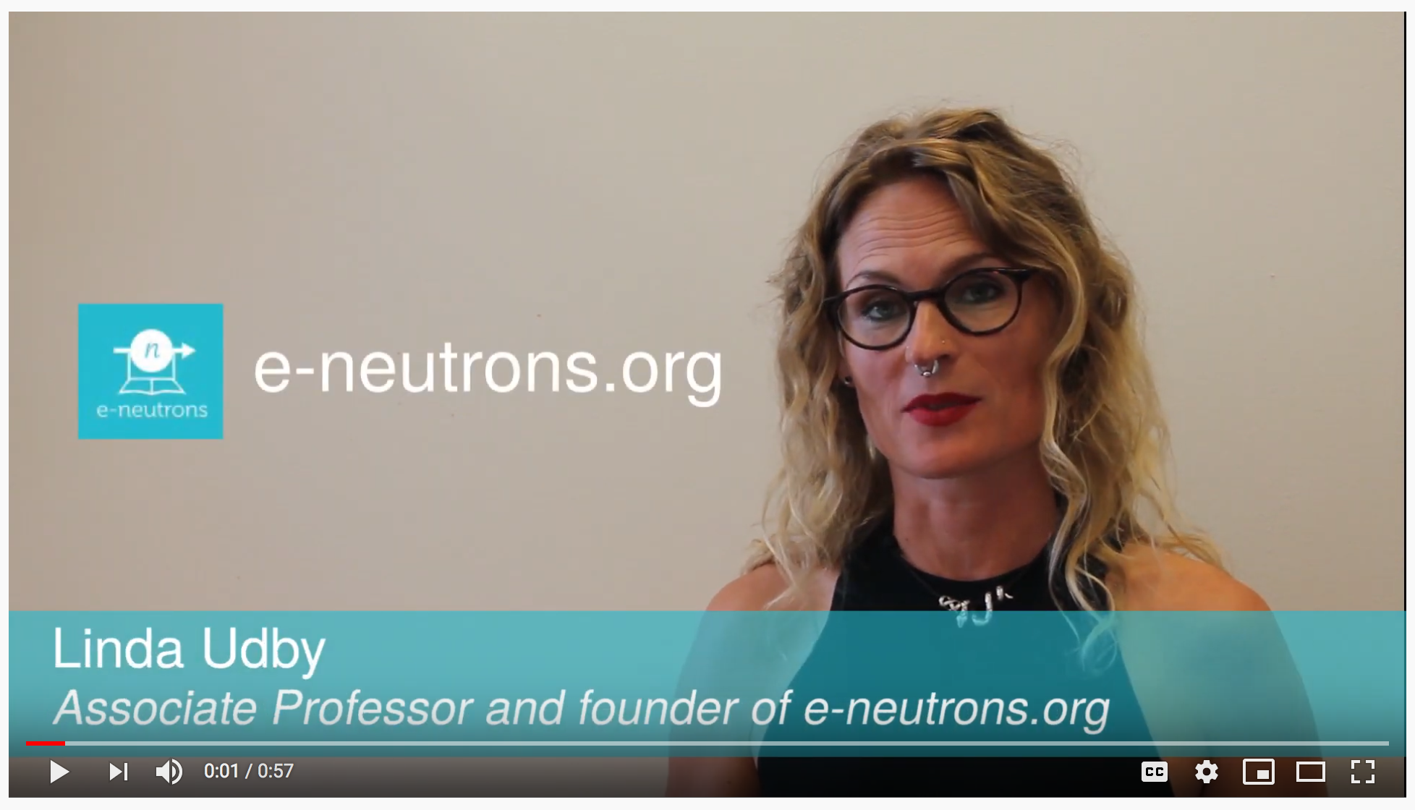
What is e-neutrons.org?
1 min PR video
https://www.youtube.com/watch?v=F0AEQBBbMgo&feature=youtu.be
2 min PR video
https://www.youtube.com/watch?v=LvRVnPoAkNs&feature=youtu.be
3:30 min video specifically for teachers
https://www.youtube.com/watch?v=1rTXrTttScE&feature=youtu.be

Slide 8

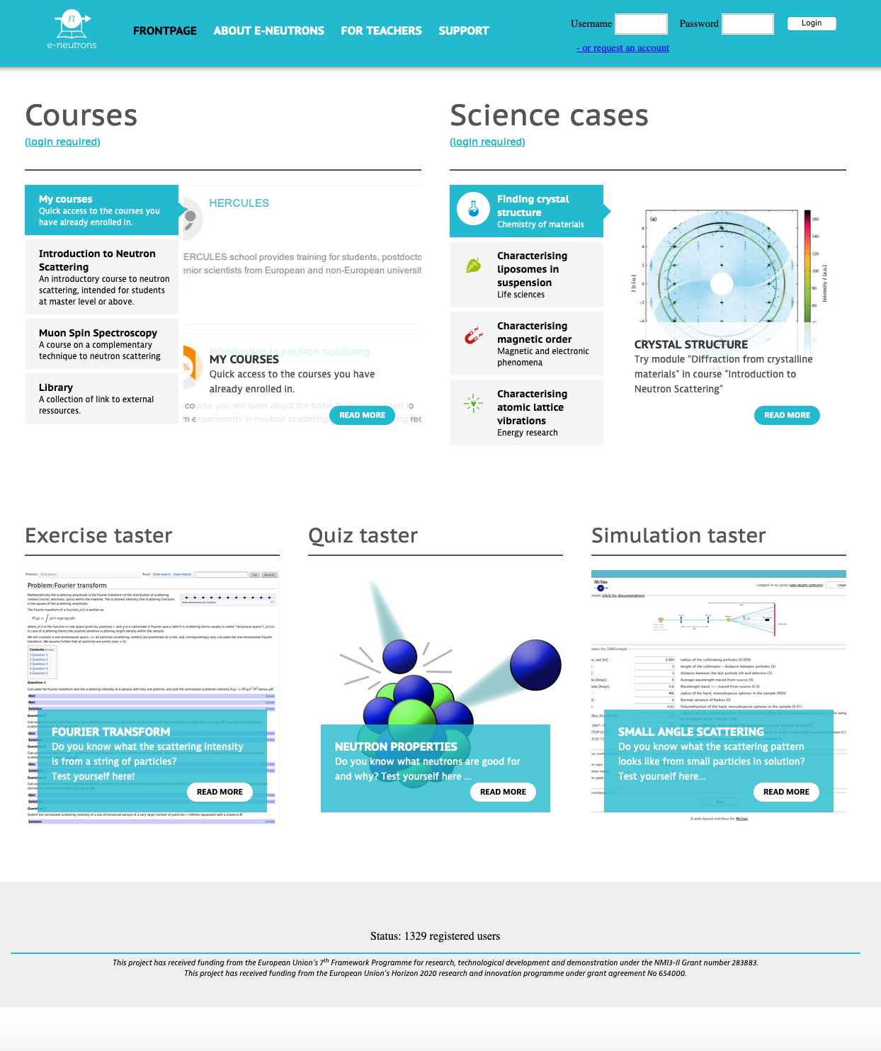








Website frontend
Learning management system
Course material
Quizzes
Hooks to other tools
Wiki-“textbook”
Online simulator
Virtual visit to scattering facility
Data-analysis in the browser
Open questions
Branding
Domain name, e.g.
training.panosc.eu
panosc.education
e-panosc.org
e-facility.org
AAI & EOSC Integration

Slide 9

Jupyter integration
Entire workflows can be performed in Jupyter:
Load data
Data reduction
Data analysis
WP3/4
WP4

Slide 10
Jupyter
Entire workflows can be performed in Jupyter:
Load data
Data reduction
Data analysis
WP3/4
WP4
Experiment simulations
Data reduction
Data analysis
Conversion
Modelling
WP5

Slide 11
Jupyter
Entire workflows can be performed in Jupyter:
Load data
Data reduction
Data analysis
WP3/4
WP4
Experiment simulations
Data reduction
Data analysis
Conversion
Modelling
WP5
WP4

Slide 12
Jupyter
Entire workflows can be performed in Jupyter:
Experiment planning
(New type of) data analysis
Tutorials
Load data
Data reduction
Data analysis
WP3/4
WP4
Experiment simulations
Data reduction
Data analysis
Conversion to S(q,w)
Modelling (MD, DFT, phem. Models etc)
WP5
WP4

Slide 13
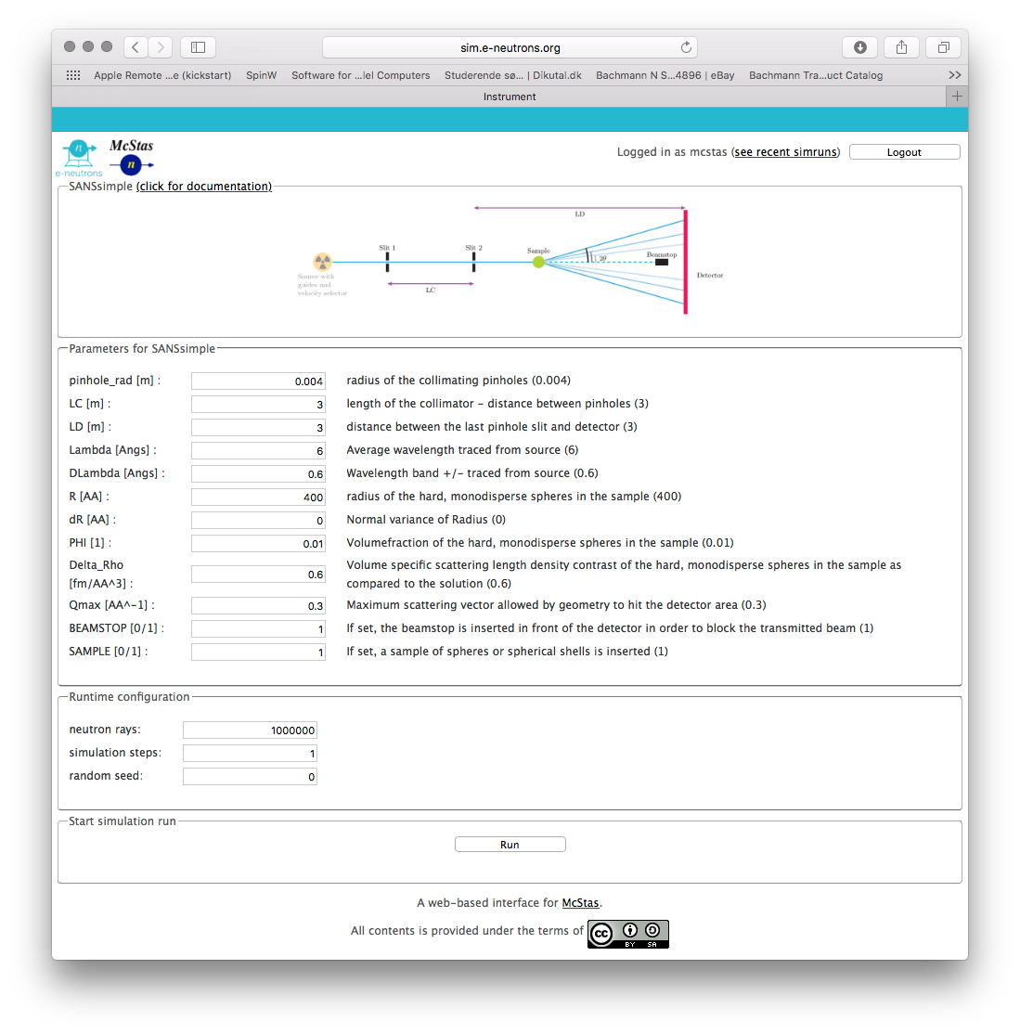
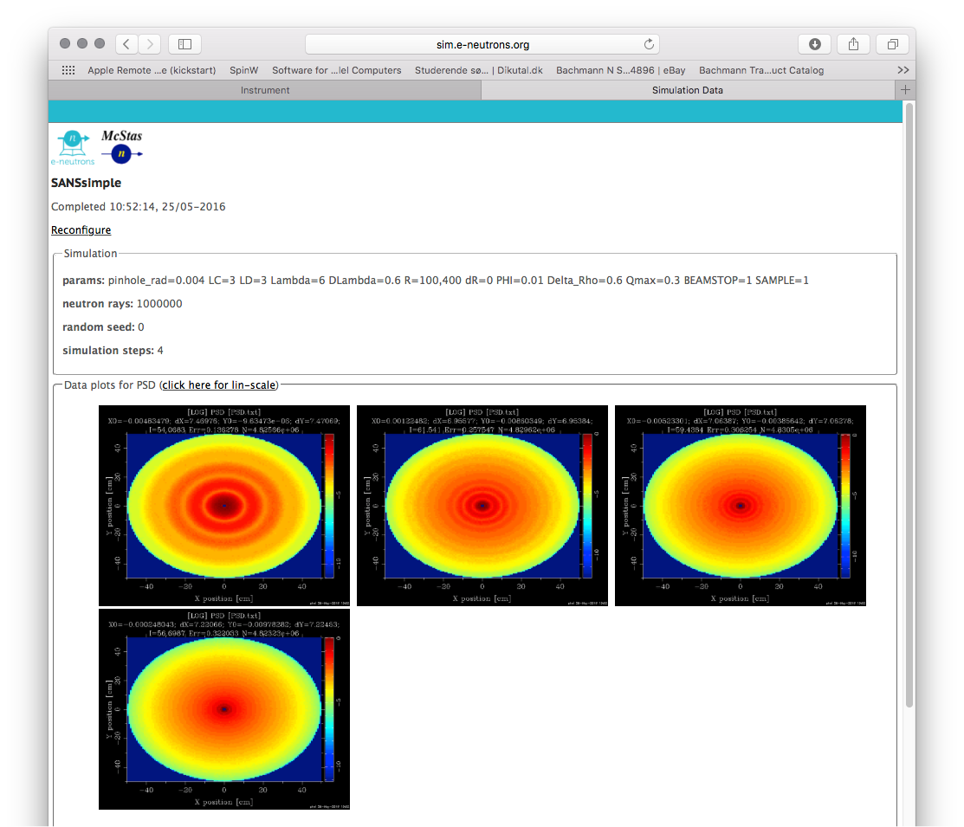
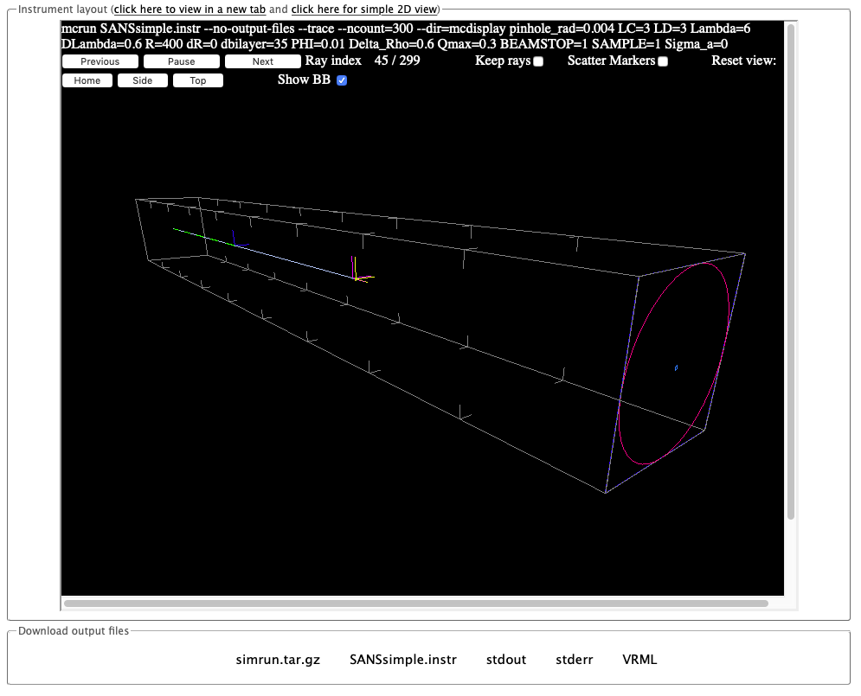
Also more GUI like interface

Slide 14
Task 8.3 Integration of partner ESFRIs
Tasks | 2019 |  |  |  | 2020 |  |  |  | 2021 |  |  |  | 2022
T8.1 Migration to ESS
T8.2 Jupyter integration
T8.3 Partner integration
Analysis (WP4)
Python based software to be run from Jupyter, to allow for interactive tutorials and hands-on training.
Simulation (WP5)
Instrument simulations / virtual experiments to be run from web widgets or Jupyter
Led by ESS.
Input from
WP4 & 5

Slide 15
E-learning (and WP4 & 5) requirements to EOSC
Easy and inter-operable (Python) access to data
Easy access to analysis services with required underpinning hardware
Data can be easily migrated to where they are needed
Federated access
Solutions should be sustainable and long-lasting
Specifically:
When a course takes place, all students need computing power simultaneously

Slide 16
Task 8.4, 5 Staff training
Tasks | 2019 |  |  |  | 2020 |  |  |  | 2021 |  | 2022
T8.4 E-learning
T8.5 Data stewardship
Led by ESS (and in turn the expert Linda Udby)
but
WHOM?
and
WHAT?
Led by ELI.
Input from WP2

Slide 17
T8.5 Staff training (M12-M42)
There will be one or two workshop(s) next year but for this to be efficient
Each partner appoints course/training responsible and ”development team” (Consider young scientists)
Each partner develops learning goals / curriculum Each partner produce/collect learning material in text format and/or manuscripts for videos etc. Hiring external contractors (e.g. for video production)
Convert learning material to e-learning formats Implement learning in e-learning platform Learning management at e-neutrons
Workshop I (Q1, 2020)

Slide 18
T8.5 Staff training (M12-M42)
There will be a workshop next year but for this to be efficient
Each partner appoints course/training responsible and ”development team” (Consider young scientists)
Each partner develops learning goals / curriculum Each partner produce/collect learning material in text format and/or manuscripts for videos etc. Hiring external contractors (e.g. for video production)
Convert learning material to e-learning formats Implement learning in e-learning platform Learning management at e-neutrons
Workshop I (Q3, 2020)
Workshop II
(Q1, 2021)
Notes:
Discussion of how many and when. Shown is Linda’s suggestion?

Slide 19
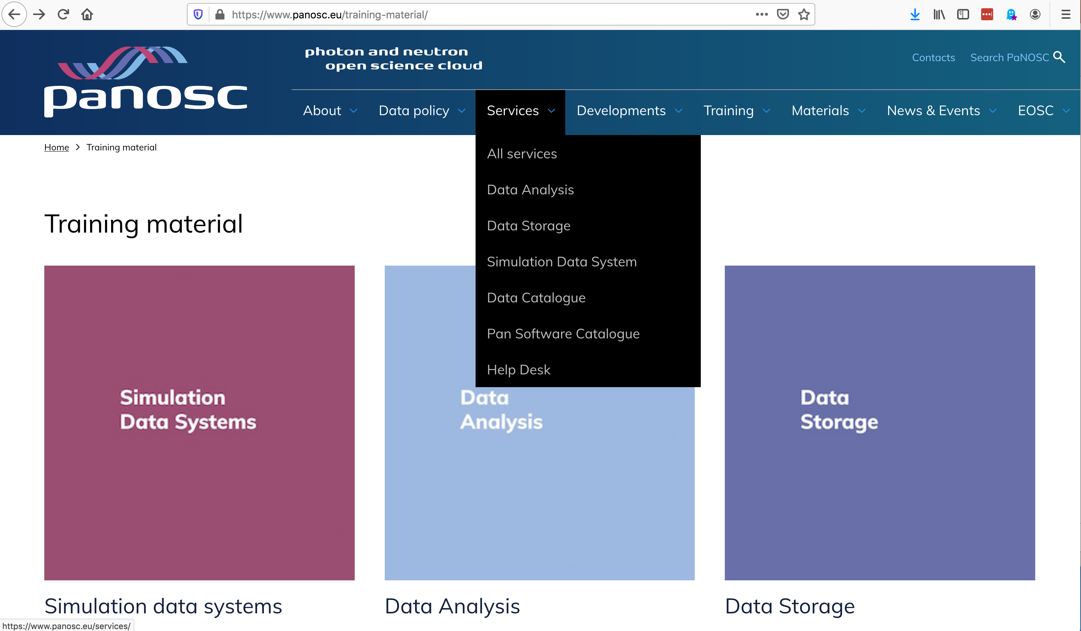
Task 8.6-8 User training
Tasks | 2019 |  |  |  | 2020 |  |  |  | 2021 |  |  |  | 2022
T8.6 PaNOSC Services
T8.7 P&N Sources
T8.8 Summer school
Led by ELI.
Input from WP3-6, 8
Led by ESS & ELI.
Base on staff training with input from partners

Slide 21
Collaboration with ExPaNDS
ExPaNDS WP leader: Majid (SOLEIL)
Will coordinate with corresponding WP in ExPanDS and align meetings
Current task is to collect and get overview of existing training material – national facilities is a good source for obtaining training material

Slide 22
Summary
WP8 provisions an e-learning service and teaching material
Only ESS activity so far
We start to enter face where we need commitment from other partners
Identify right persons for staff training at partner facilities
Input from service development WPs (remember training material / user manual)
Use WP8 associated persons for testing?
One or two workshops will be planned for next year (who should participate from your side?)
Will collaborate with ExPaNDS

Slide 23
Thank you
Thomas.rod@esss.se

